Slide 1
Regression Analysis
Poisson Regression
Nicoleta Serban, Ph.D.
Professor
Stewart School of Industrial and Systems Engineering
Model Estimation: Data Example

Slide 2

About This Lesson

Slide 3
Data Example 1: High School Awards
Objective: To model and predict the number of awards earned by students at one high school for multiple high schools.
Response Variable: The number of awards earned by students at a high school per year
Predicting Variables:
The type of program in which the student was enrolled, with three levels: 1 = "General", 2 = "Academic" and 3 ="Vocational"; and
The score on the final exam in math.
Acknowledgement: This data example was acquired from the Institute for Digital Research and Education at University of California, Los Angeles.

Slide 4
GOF: Standard Linear Regression
## Fit a standard regression model
m0 = lm(num_awards ~ prog + math, data=awardsdata)
## Residual Analysis for Goodness of Fit
par(mfrow = c(2,2))
plot(awardsdata$math, res, xlab = "Math Exam Score", ylab = "Residuals", pch = 19)
abline(h = 0)
plot(fitted(m0), res, xlab = "Fitted Values", ylab = "Residuals", pch = 19)
abline(h = 0)
hist(res, xlab="Residuals", main= "Histogram of Residuals")
qqnorm(res)
qqline(res)

Slide 5
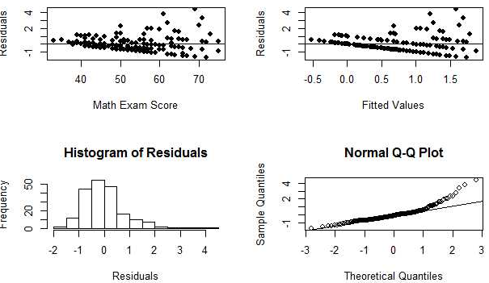
GOF: Standard Linear Regression

Slide 6
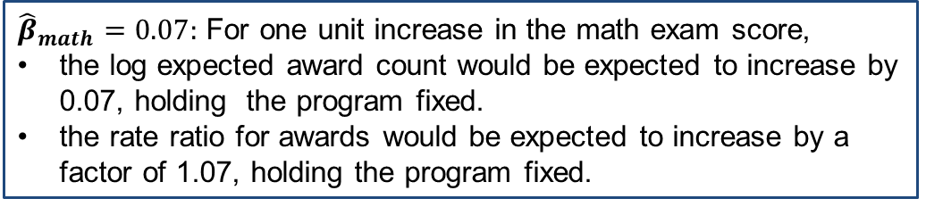
Poisson Regression Estimation
m1 = glm(num_awards ~ prog + math, family="poisson", data=awardsdata)
summary(m1)
Coefficients:
 | Estimate | Std. Error | z value | Pr(>|z|)
(Intercept) | -5.24712 | 0.65845 | -7.969 | 1.60e-15 ***
progAcademic | 1.08386 | 0.35825 | 3.025 | 0.00248 **
progVocational | 0.36981 | 0.44107 | 0.838 | 0.40179
math | 0.07015 | 0.01060 | 6.619 | 3.63e-11 ***
${\hat{β}}_{math}=0.07:$ For one unit increase in the math exam score,
the log expected award count would be expected to increase by 0.07, holding the program fixed.
the rate ratio for awards would be expected to increase by a factor of 1.07, holding the program fixed.

Slide 7
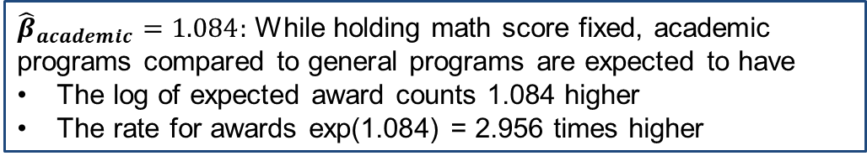
Poisson Regression Estimation
m1 = glm(num_awards ~ prog + math, family="poisson", data=awardsdata)
summary(m1)
Coefficients:
 | Estimate | Std. Error | z value | Pr(>|z|)
(Intercept) | -5.24712 | 0.65845 | -7.969 | 1.60e-15 ***
progAcademic | 1.08386 | 0.35825 | 3.025 | 0.00248 **
progVocational | 0.36981 | 0.44107 | 0.838 | 0.40179
math | 0.07015 | 0.01060 | 6.619 | 3.63e-11 ***
${\hat{β}}_{academic}=1.084:$ While holding math score fixed, academic programs compared to general programs are expected to have
The log of expected award counts 1.084 higher
The rate for awards exp(1.084) = 2.956 times higher

Slide 8
Data Example 2: Insurance Claims
Objective: To explain factors that are associated to car insurance claims due to accidents or other events leading to car damage.
Response Variable: The number of car insurance claims per policyholder:
Holders: numbers of policyholders; and
Claims: numbers of claims
Predicting Variables:
District of residence of policyholder (1 to 4): 4 is major cities.
Classification of cars with levels <1 litre, 1–1.5 litre, 1.5–2 litre, >2 litre.
Age group of the policyholder: <25, 25–29, 30–35, >35.

Slide 9
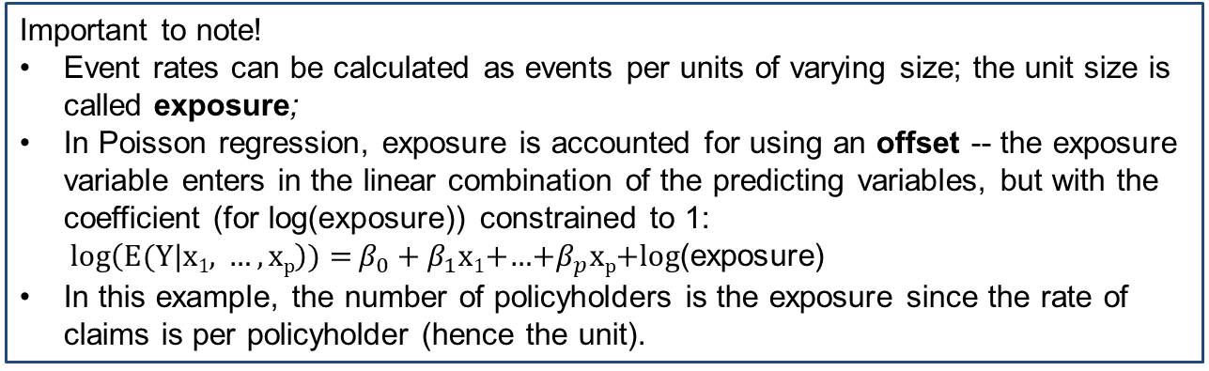
Poisson Regression Estimation
m.ins = glm(Claims ~ District + Group + Age + offset(log(Holders)), data = Insurance, family = poisson)
Important to note!
Event rates can be calculated as events per units of varying size; the unit size is called exposure;
In Poisson regression, exposure is accounted for using an offset -- the exposure variable enters in the linear combination of the predicting variables, but with the coefficient (for log(exposure)) constrained to 1:
${log\left(E(Y|\text{x}\text{1}\text{, }…,\text{x}\text{p}\right)){=}β}_{0}+β_{1}\text{x}\text{1}$+…+$β_{p}\text{x}\text{p}$+log(exposure)
In this example, the number of policyholders is the exposure since the rate of claims is per policyholder (hence the unit).

Slide 10

Summary

